Slide 1
PCLint execution and Message justification

Slide 2
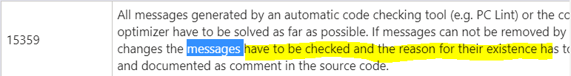
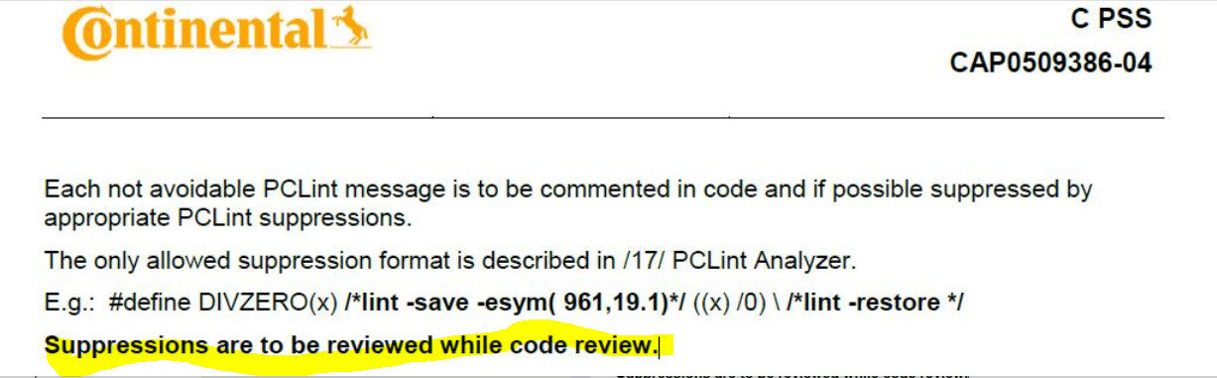

PCLint messages
The PCLint messages will be generated:
  1. locally on the developer PC by the PCLint tool and will be printed in the console window of the IDE (WR workbench)
  2. automatically collected and reported by CI Automatization Server and reported as *.xls report
It will show
  the affected file and location
  the deviation e.g. MISRA rule
  the Lint suppressions
Consider also the Code review questions and CAP0509386_SW_Testing_Product_Software
Gabriel Andriescu / 9-Feb-2011 © Continental AG

Slide 3
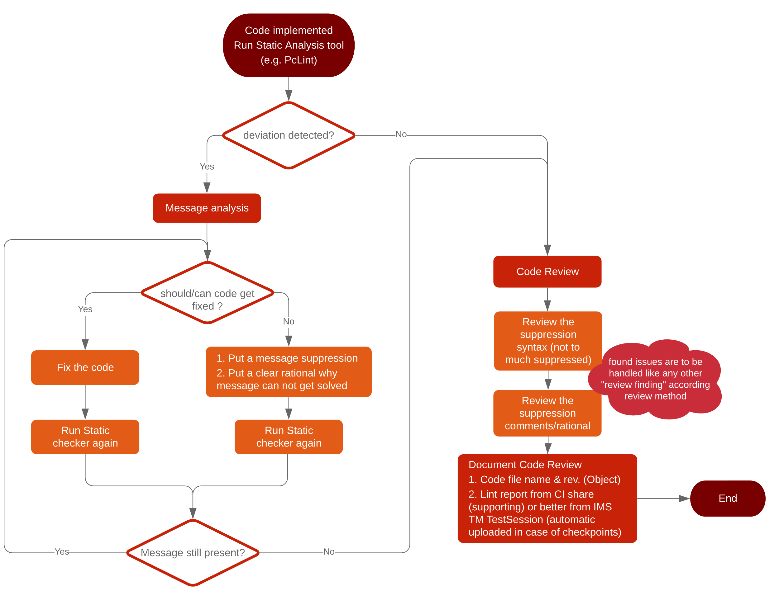
General Workflow
Daniel Göpelt June/2020 © Continental AG

Slide 4
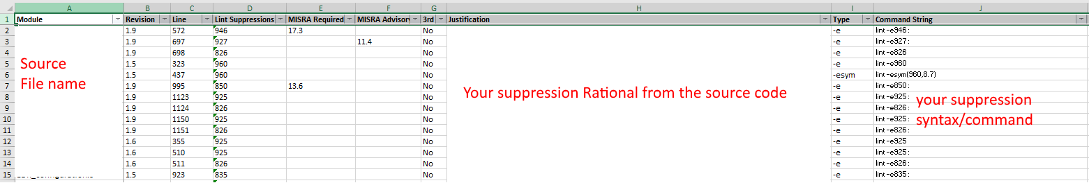
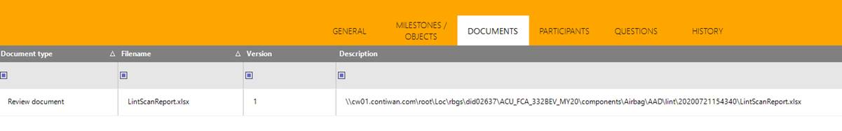
Suppression report
The suppression report can be found on CI share:
\\cw01.contiwan.com\root\loc\rbgs\did02637\<YourProject>\components\<yourCOmponent>\lint\<your Checkpoint>\LintScanReport.xlsx
See also:
https://confluence.conti.de:8090/x/NrQ2BQ
Documentation within the Code review: reference to the LintScan report
Gabriel Andriescu / 9-Feb-2011 © Continental AG

Slide 5
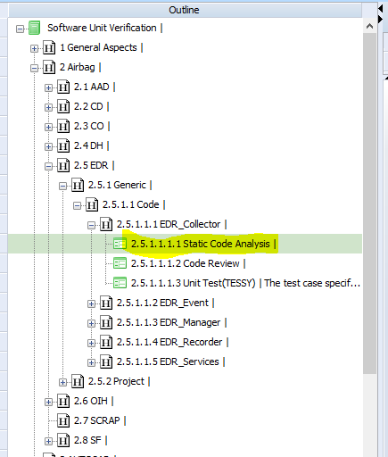
Suppression report
Additionally the Lint report can be found in IMS TM
Gabriel Andriescu / 9-Feb-2011 © Continental AG

Slide 6
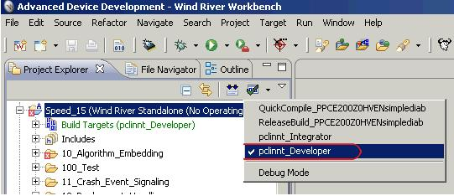
PCLint execution – SW Developer Run
Set the active build spec as Developer.
Gabriel Andriescu / 9-Feb-2011 © Continental AG

Slide 7
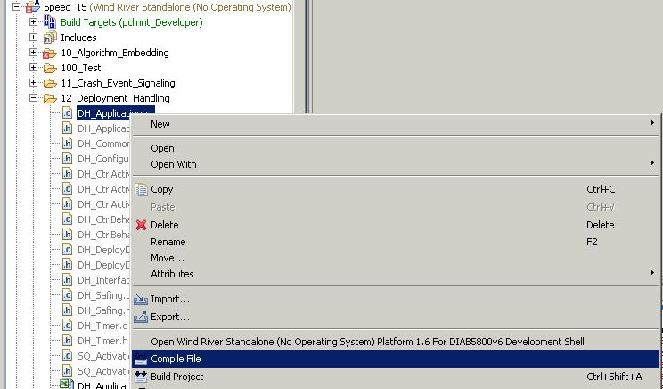
PCLint execution – SW Developer Run
Select the file for analysis and compile it..
Gabriel Andriescu / 9-Feb-2011 © Continental AG

Slide 8
PCLint Message Suppression – How to do it
If the PCLint Message can not be removed or the effort to remove the message is too big then, if the technical risk is low, the SW developer can obtain a clean PCLint report by suppressing the PCLint message. The SW developer is responsible for analyzing the message prior to suppression.
In order to suppress a PCLint message, all suppression syntaxes can be used:
  PREFERED:
  -/+esym(#,Symbol) - control message by number, symbol
  -esym( 961,19.1) // suppresses message 961 for MISRA rule 19.1 only (other rules with 961 stay active)
  -/+e# - message number(s) #
  -e(#) - message # for the next expression
  --e(#) - message # for the current expression
  -/+elib(#) - control message(s) in library headers
  -/+elibsym(#) - for a library symbol
  -/+emacro(#,Symbol) - within a macro
  --emacro((#),Symbol) - for entire expression in which macro is embedded
  ! e# - one-line error suppression
Gabriel Andriescu / 9-Feb-2011 © Continental AG

Slide 9
PCLint Analyzer – PCLint Message Suppression – Restrictions
The SW developer has to analyze the possible side effects of the PCLint message and then perform the suppression. If side effects are present suppression is not allowed.
The PCLint message suppression it is to be restricted to a minimal scope “one line or as few as possible”.
After the code line for which the message suppression was made, a mandatory message enable shall be placed in case an disable/enable syntax is used(e.g -/+esym(960,11.3) )
Mandatory:
use for –exxx suppressions the –save ... –restore syntax in order to avoid unwanted side effects.
!!! –esym( ) does not work with –save/-restore !!!
preferable use: -esym(xxx,yyy) syntax. Details see PcLint user manual
Avoid using the pure “-e960/-e961” suppression syntax as it disables more than one message.
The explanation MUST contain the reason of the suppression.
The explanation must be stated continuously, not interrupted by EOL and continued on the next line.
Gabriel Andriescu / 9-Feb-2011 © Continental AG

Slide 10
PCLint Analyzer – PCLint & Message Suppression – Reporting
The PCLint Static check (documented in Test management tool) shall contain the generated excel document, consisting of 2 sheets:
  PCLint_Messsage ->where all PCLint messages are documented
  PCLint _Suppression -> where all PCLint suppressions are documented
For the code review the excel file has to be available.
The PCLint Message and PCLint Suppresion reports shall be reviewed during the code review and agreed by the review participants.
Gabriel Andriescu / 9-Feb-2011 © Continental AG

Slide 11
PCLint Analyzer
1st generation

Slide 12
PCLint Analyzer – General aspects
The PCLint analyzer consist of 3 main functions:
  PCLint message documentation
  PCLint Message Suppression
  PCLint Configuration check
1 / Gabriel Andriescu / 9-Feb-2011 © Continental AG

Slide 13
PCLint Analyzer – PCLint Configuration check
The PCLint Configuration files located in the SW Developer’s PWS are checked to see if they match with the standard ones from Version management system.
A checksum is calculated over the configuration files and it is compared with the one calculated by the SW Integrator.
In case of a mismatch an error message is produced.
Gabriel Andriescu / 9-Feb-2011 © Continental AG

Slide 14
PCLint Analyzer – PCLint documentation
The PCLint messages generated by the PCLint tool will be, in addition, automatically documented in an excel file.
The first sheet, named PCLint Message, of this excel file will contain all the messages generated by PCLint.
The report will contain:
  Continental Automotive copyright information
  runtime
  run-date
  version of analyzed file (from source file header)
  PVCS check-in date and time
  version responsible (from source file header)
Gabriel Andriescu / 9-Feb-2011 © Continental AG

Slide 15
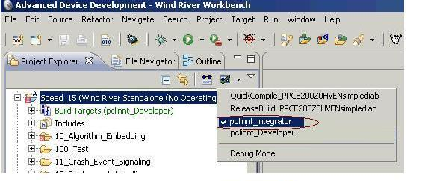
PCLint Analyzer – PCLint Configuration check – SW Integrator Run
The script will generate a Standard_checksum.txt file in the ProjectDir/Temp/PCLint_Integrator folder.
This file will be placed in PVCS in the ProjectDir/07_Environment/Lint folder and labeled accordingly.
When the SW Team will get the labeled project from Version management system the Standard_Checksum.txt file will be placed in ProjectDir/.../Lint folder.
Steps for SW Integrator run:
Set the active build spec as Integrator.
Gabriel Andriescu / 9-Feb-2011 © Continental AG

Slide 16
PCLint Analyzer – PCLint Configuration check – SW Integrator Run
Select a file for analysis and compile it..
Gabriel Andriescu / 9-Feb-2011 © Continental AG

Slide 17
PCLint Analyzer – PCLint Configuration check – SW Developer Run
Set the active build spec as Developer.
Gabriel Andriescu / 9-Feb-2011 © Continental AG

Slide 18
PCLint Analyzer – PCLint Configuration check – SW Developer Run
Select the file for analysis and compile it..
Gabriel Andriescu / 9-Feb-2011 © Continental AG

Slide 19
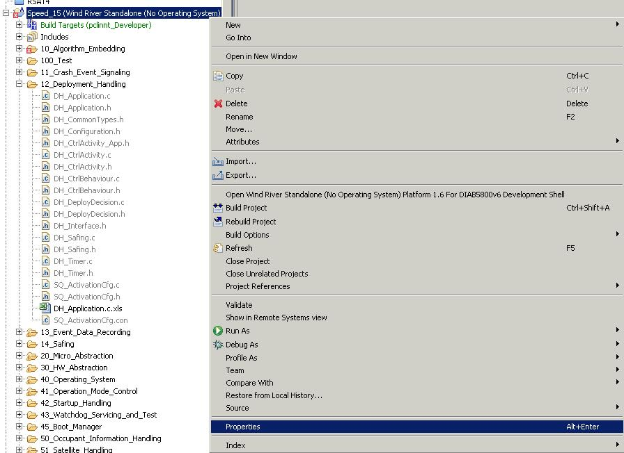
PCLint Analyzer – Windriver Workbench Configuration
Open WindRiver Workbench and load the project. Right click on the project name and select Properties.
Gabriel Andriescu / 9-Feb-2011 © Continental AG

Slide 20
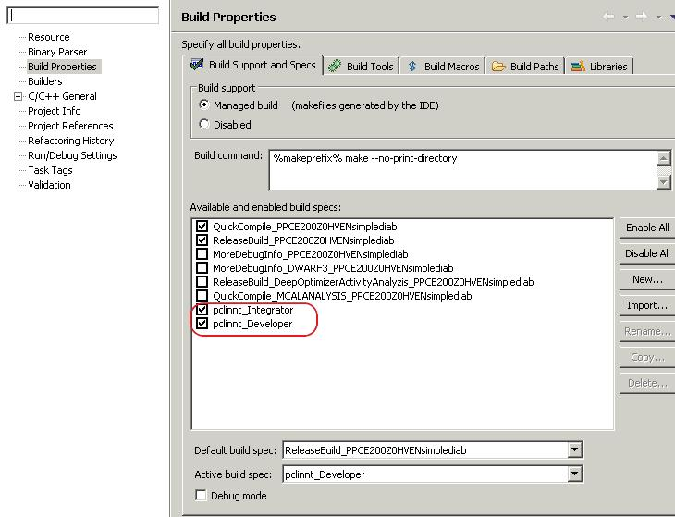
PCLint Analyzer – Windriver Workbench Configuration
Select Build Properties and create 2 new build specs – one for the SW Integrator and one for the SW Developer.
Gabriel Andriescu / 9-Feb-2011 © Continental AG

Slide 21
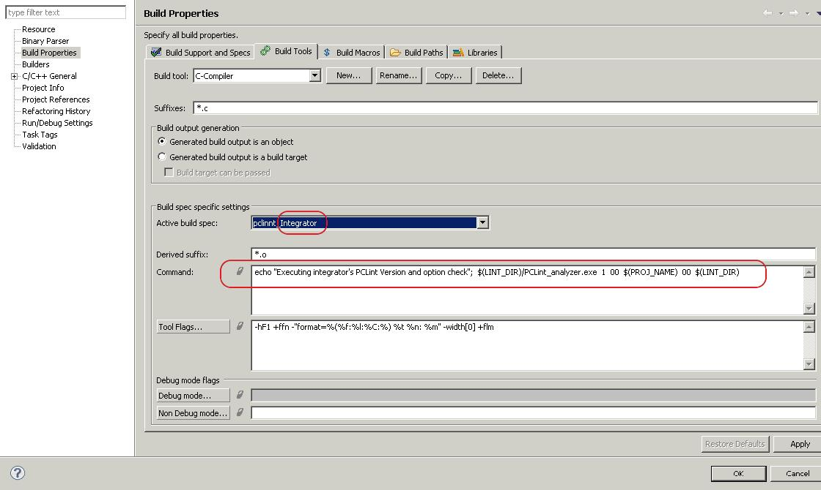
PCLint Analyzer – Windriver Workbench Configuration – SW Integrator Legacy Version of LintAnalyzer
In Bulid tools, select the Active build spec as SW Integrator and fill in the command field with the following command:
echo "Executing integrator's PCLint Version and option check"; $(LINT_DIR)/PCLint_analyzer.exe 1 00 $(PROJ_NAME) 00 $(LINT_DIR)
Gabriel Andriescu / 9-Feb-2011 © Continental AG

Slide 22
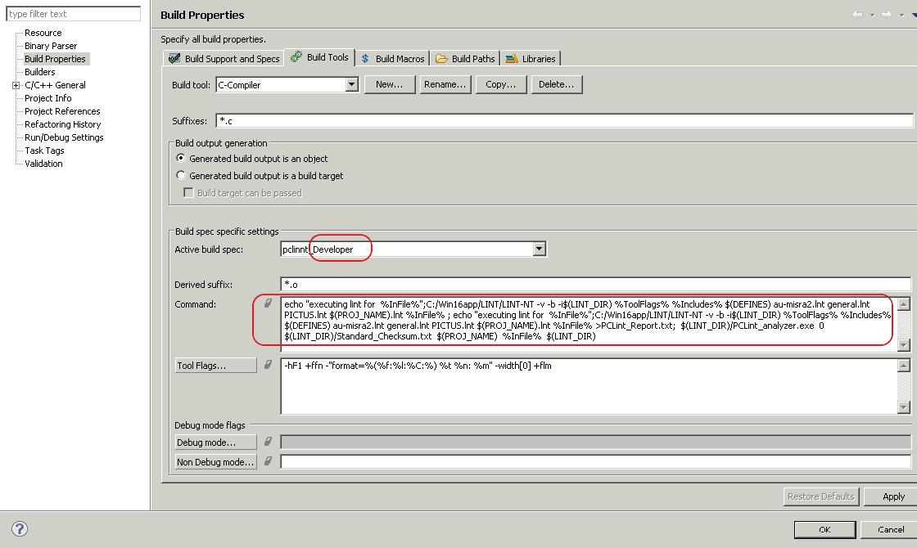
PCLint Analyzer – Windriver Workbench Configuration – SW Developer Legacy Version of LintAnalyzer
In Bulid tools, select the Active build spec as SW Developer and fill in the command field with the following command:
echo "executing lint for %InFile%";C:/Win16app/LINT/LINT-NT -v -b -i$(LINT_DIR) %ToolFlags% %Includes% $(DEFINES) au-misra2.lnt general.lnt PICTUS.lnt $(PROJ_NAME).lnt %InFile% ; echo "executing lint for %InFile%";C:/Win16app/LINT/LINT-NT -v -b -i$(LINT_DIR) %ToolFlags% %Includes% $(DEFINES) au-misra2.lnt general.lnt PICTUS.lnt $(PROJ_NAME).lnt %InFile% >PCLint_Report.txt; $(LINT_DIR)/PCLint_analyzer.exe 0 $(LINT_DIR)/Standard_Checksum.txt $(PROJ_NAME) %InFile% $(LINT_DIR)
Gabriel Andriescu / 9-Feb-2011 © Continental AG

Slide 23
PCLint Analyzer – Advantages
Advantages
  A standard PCLint message documentation – everybody will have an excel file containing the static check messages
  Better control of suppressed messages – always know what message is suppressed and why
  Clear comment of the suppressed message = comment of the produced message
  The comment of the message is always kept for the same line of code
  Same configuration files used by the entire project team
New question for delta code review:
  Has PCLint suppression comment validity been confirmed for the modified code?
    Explanation: In case of modifying a line for which suppression is used, the reviewers/SW developer have to check if the suppression comment is valid also for the new code.
Gabriel Andriescu / 9-Feb-2011 © Continental AG

